Slide 1
Test Bed for Industrial Wireless Communications: A Collaborative Robot Work-Cell Use Case
Yongkang Liu
2019-05-08

Slide 2
Agenda
Goals and objectives
Test bed overview
Initial results

Slide 3
Goals and Objectives
Build a measurement platform for evaluating wireless capabilities of supporting mission-critical industrial communications
Collect data from production operations, machining tools, and networks
Unveil interactions between operational technologies (OT) and information technologies (IT) in discrete manufacturing processes
Test various network techniques to support low-latency, high reliable data transmissions
Verify modeling methods and statistical patterns

Slide 4
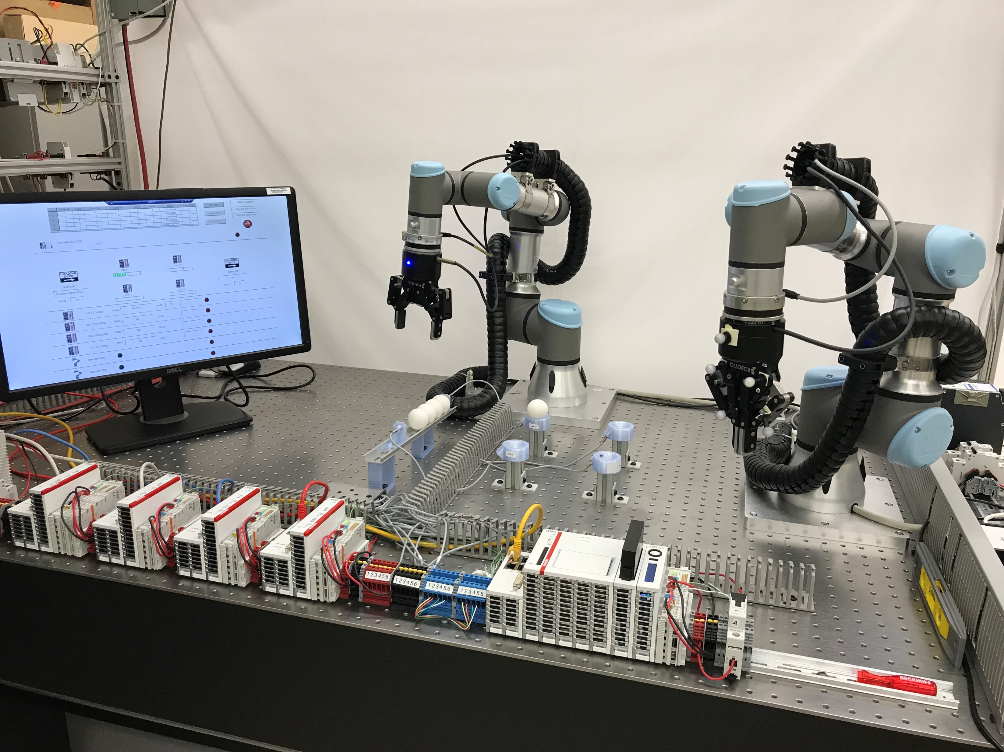
A Collaborative Robot Work-Cell
Robots
HMI
Queue
Machining tools
Supervisor

Slide 5
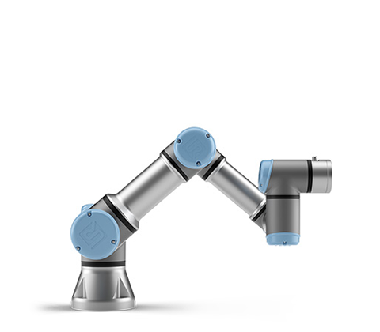

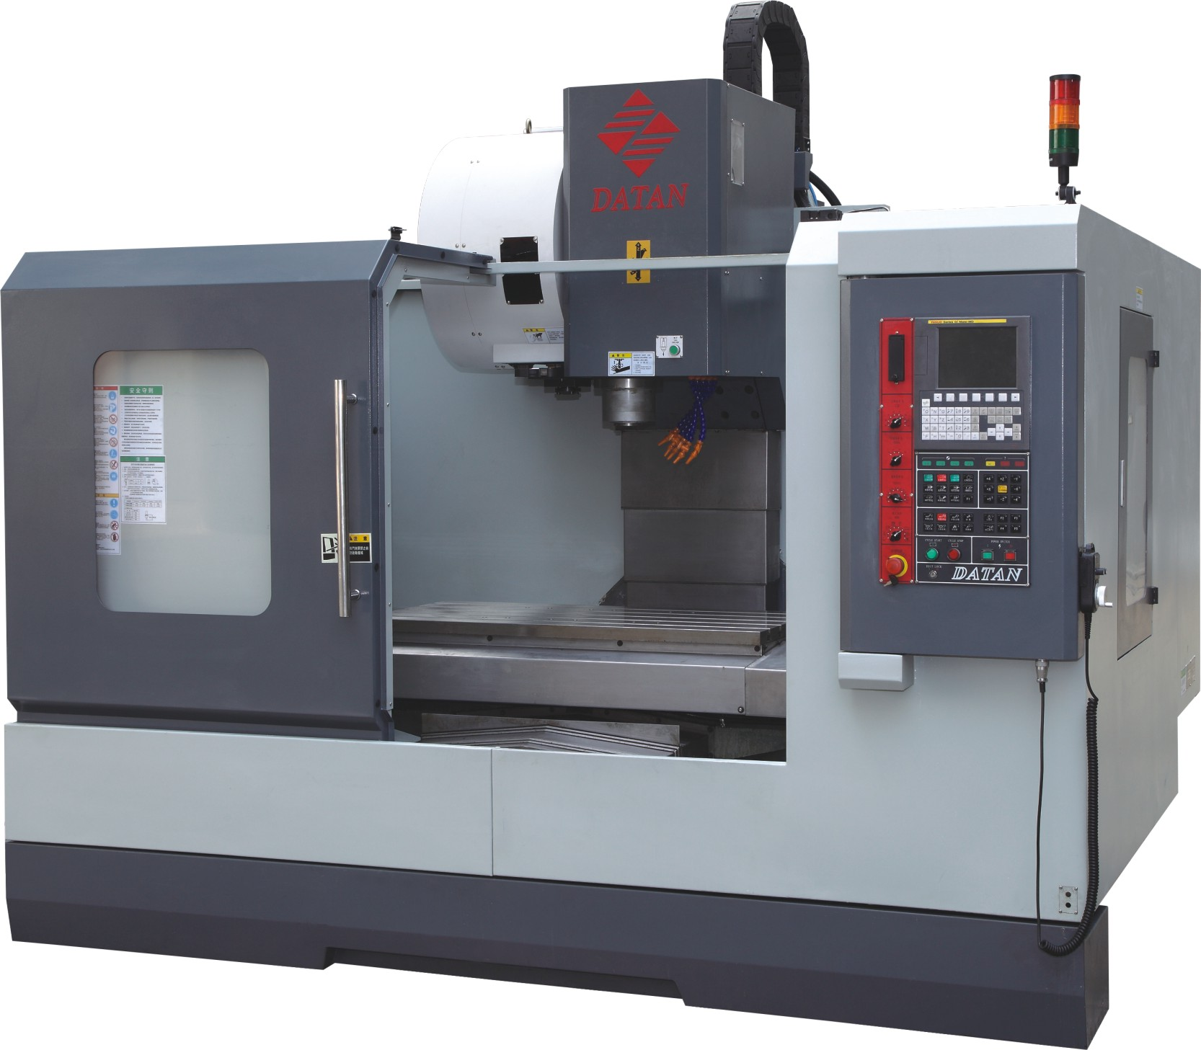
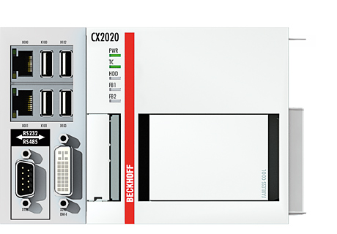
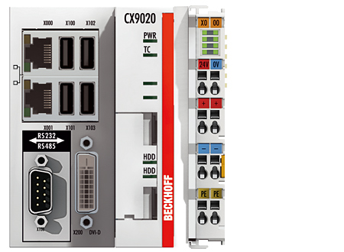
Work-Cell Use Case – Robotic Machine Tending
Work Station Array
Job Queue
Inspector
A
B
C
D
Operator
Supervisor
CNC (Emulator)
Notes:
Probing sensors are attached to the inspector to obtain the real inspection result
Overview of the operation procedures (physical part)
Operator: deliver
Inspect: inspection
Workstation (pedestal): processing

Slide 6

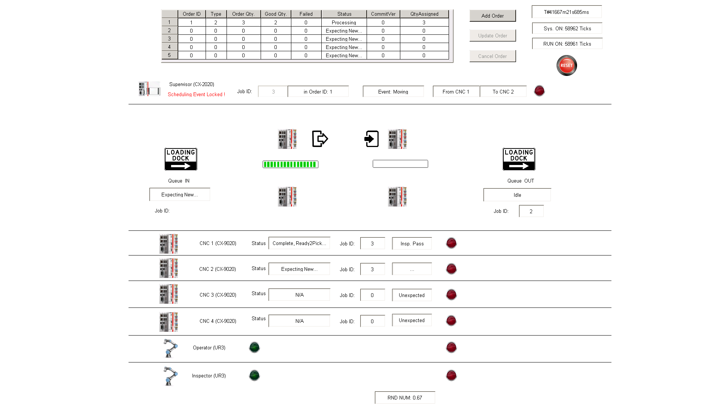

Visualization
HMI
Supervisor
VisuRules()
Order-Based
Order_main()
gvOrder
gvSys
gvSch
SCHDL_main()
I/O
Queue_main()
gvQueue
CNC_1_main()
arrCNC[1]
gvCNC
SCHDL_Sub_Queue()
CNC_2_main()
arrCNC[2]
Job-Based
ADS
CNC_3_main()
arrCNC[3]
SCHDL_Sub_CNC()
CNC_4_main()
arrCNC[4]
Modbus
UR_OPT_main()
gvUR1
UR_INS_main()
gvUR2
SCHDL_Sub_INS()
Interfaces
Variable Lists
Scheduler
Notes:
Supervisor code is maintained at the project’s GitLab repo:
https://gitlab.nist.gov/gitlab/el-wireless/el-iws-workcell/tree/plcFeature/PLC/TwinCAT_Emulator_Server

Slide 7
Work-Cell Use Case – Robotic Machine Tending
Work Station Array
Job Queue
Inspector
A
B
C
D
Operator
Supervisor
CNC (Emulator)
Notes:
Probing sensors are attached to the inspector to obtain the real inspection result
Overview of the operation procedures (physical part)
Operator: deliver
Inspect: inspection
Workstation (pedestal): processing

Slide 8
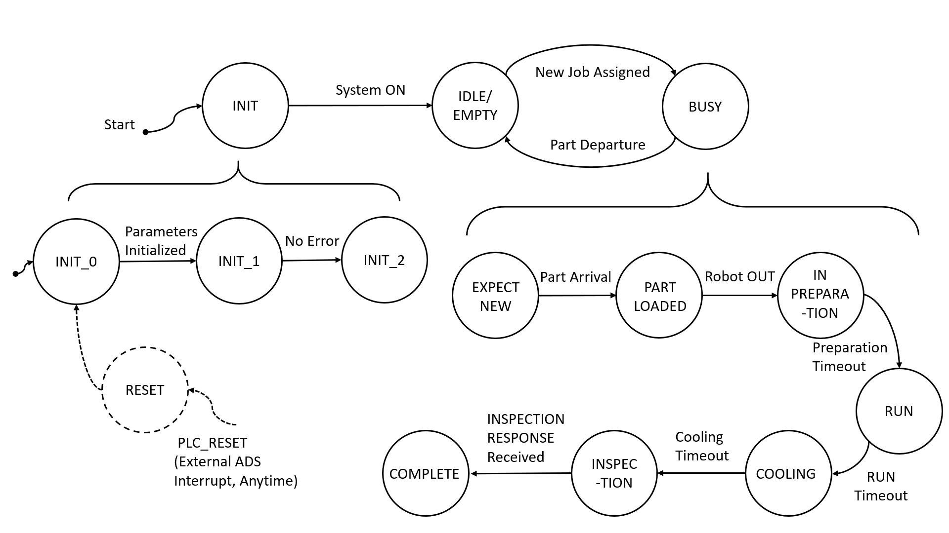
CNC Emulator
gvSys
ADS
gvSta
STA_main()
gvComm
COMM_main()
IOI_main_IN()
I/O
gvIoi
IOI_main_OUT()
gvDiag
DIAG_main()
Variable Lists
Function Modules
Notes:
CNC Emulator
In the architecture, functions are grouped by their roles: processing, communication, I/O, and diagnostics.
Emulator code is maintained at the project’s GitLab repo:
https://gitlab.nist.gov/gitlab/el-wireless/el-iws-workcell/tree/plcFeature/PLC/TwinCAT_Emulator_CNC

Slide 9
Work-Cell Use Case – Robotic Machine Tending
Work Station Array
Job Queue
Inspector
A
B
C
D
Operator
Supervisor
CNC (Emulator)
Notes:
Probing sensors are attached to the inspector to obtain the real inspection result
Overview of the operation procedures (physical part)
Operator: deliver
Inspect: inspection
Workstation (pedestal): processing

Slide 10
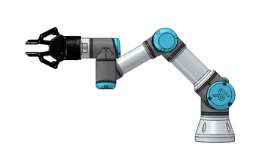
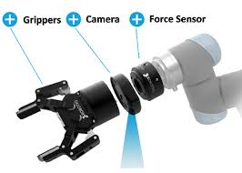
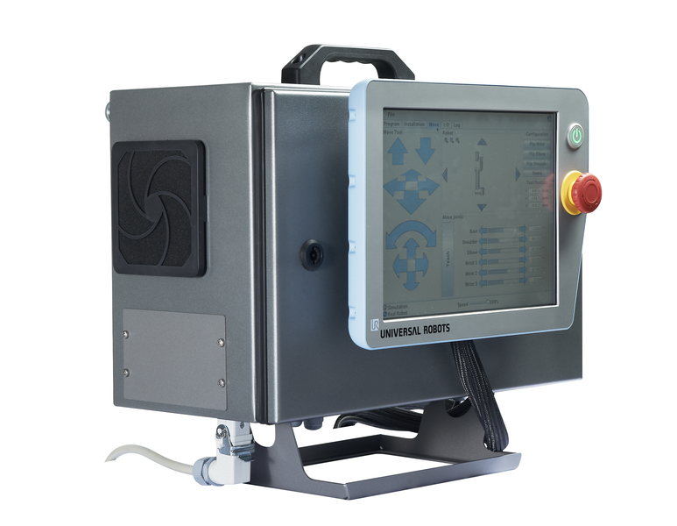
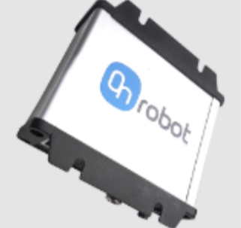
UR3 System (1/2)
A UR3 system includes a control box, a 6 Degree-of-Freedom (DoF) robot, and UR3 peripherals which we refer to as robotic end effector devices (REEDs). In this testbed, each UR3 is equipped with a gripper and a 6-axis force torque (F/T) sensor. The F/T sensor is further divided into the sensing unit and a compute box.
REEDs
(Illustration only: Camera is not used in this test bed)
UR robot
UR Control box
F/T compute box

Slide 11

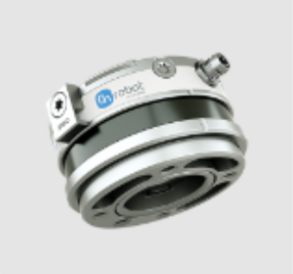


UR3 System (2/2)
REEDs communicate with UR control box
Current F/T firmware only supports an error-free Ethernet connection with the control box
Any disconnection issue leads to a system error which requires manual reset
UR robot
Gripper
UR Control box
F/T sensor
External
F/T compute box

Slide 12
One OT Procedure (Job @ y)
RC
(Optr.)
PLC
(Supvsr.)
PLC
(CNC x)
PLC
(CNC y)
RC
(Insptr.)
StaRprt: Ready@UR1
StaRprt: Complete@x
StaRprt: Empty@y
StaRprt: Ready@UR2
IF Sys. Unlocked == TRUE THEN
SCHDL: Move x to y;
Sys. Locked;
Move route:
x -> y
New Job Info.
Part Arrival
StaRprt: Ready@UR1
Robot_OUT
Sys. Unlocked;
…
Job Start
Inspect. Ready
Inspect. Req. @ y
IF Sys. Unlocked == TRUE THEN
SCHDL: Inspect @ y;
Sys. Locked;
Inspect @ y
Inspect Done @ y
Inspect. Rsp
Job Complete
StaRprt: Ready@UR2
Sys. Unlocked
…
StaRprt: Complete@y
Notes:
Key is gvSch.bMoveLocked for safety (at any moment, at most one job is moving between machines by one robot)
The inspection request has a higher priority at the scheduler and any inspection request should be queued in case the system is locked when the request arrives.

Slide 13

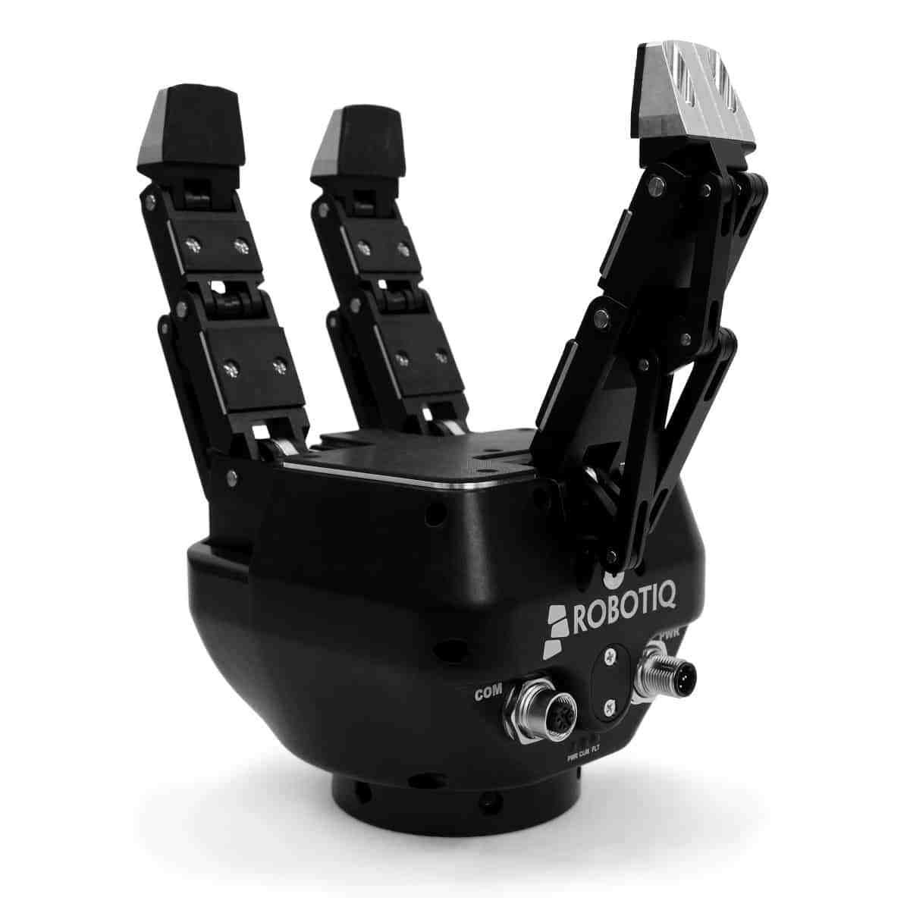
Connectivity
Measurements
Network
Switch
PLC
Supervisor
RC
Robot Controller (RC)
Analysis device
(Server)
Robotic end effectors and sensors (REES)
Process data
UR3
REES
UR3
PLCs
Measurement data
Operator
Work Station Array
Inspector
Notes:
Two parallel system layers: robot control system test use case and the measurement system
Robot control system: robots, simulated work stations, and other work-cell devices, which are connected by wires or wirelessly going through Ethernet
Measurement system: fully synchronized, capture system operation data as the reference for performance comparison

Slide 14
Test Bed Measurements
Three sets of data
Network traffic (WireShark)
TCP/IP packets: ADS/AMS, Modbus, etc.
Captured at switch’s mirroring port or at a network test access point (TAP/nTAP)
Customized subscription of OT process status
PLC (Supervisor)
UR3 status: Real-time data exchange (RTDE)
OT-IT event alignment
Accurate timing: IEEE 1588-2008 (PTPv2)
PTP-synced timestamps being available for all data collection (PLC, RTDE, WireShark)

Slide 15

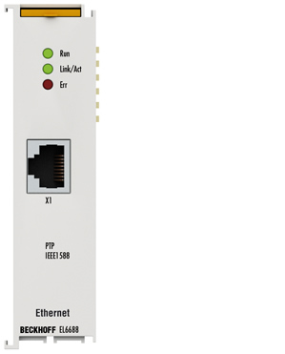
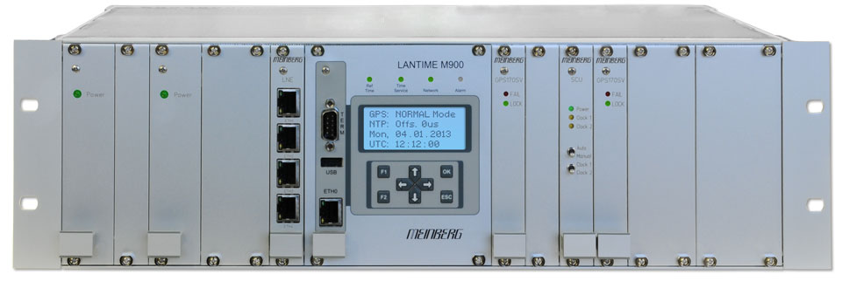

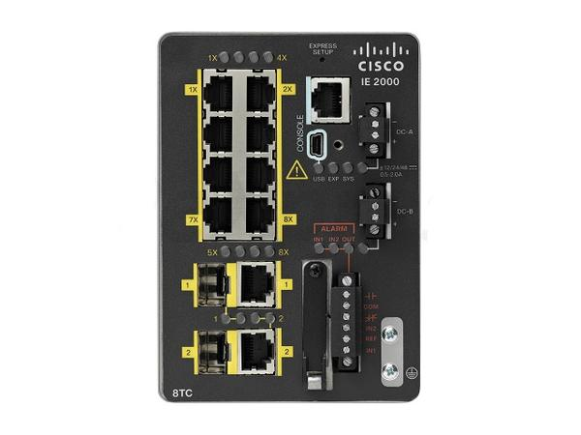
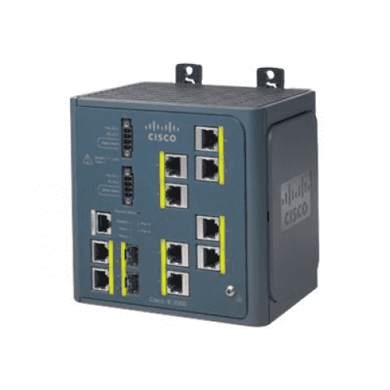
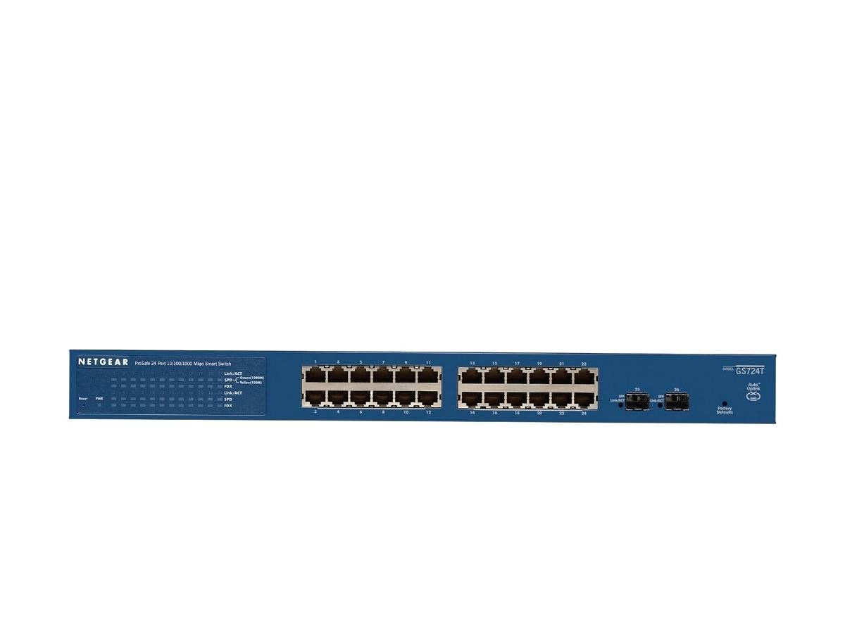
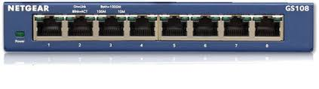


INS_F/T
Compute box
UR3 (INS)
Control box
NTP Sync
PLC
PLC 1588 Term
Grandmaster (GM)
PTP Sync
Supervisor
TSN Switch
Cisco IE-3000-8tc
Cisco IE-2000-8tc
Main Switch (24 ports)
Netgear GS9724Tv4
LinuxPTP
Netgear GS108
Port mirroring
(Ingress & Egress)
UR3 RTDE
CNC_1
CNC_2
Data Collector
Wireshark
OPT_F/T
Compute box
UR3 (OPT)
Control box
CNC_3
CNC_4
Production Subnet
Measurement Subnet
Notes:
Baseline network connections:
Production data (Green), measurement data (Red), and PTP synchronization (Purple)

Slide 16

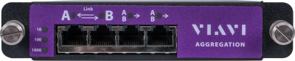
Dual TAP Measurements (Modbus)
Network analyzer
UR3
(Operator
/Inspector)
PLC
(Supervisor)
TAP
TAP
Lab Network
One-way link delay
Modbus Request (Read/Write)
Link RTT
Application
Round-trip time (RTT)
Process
-ing delay
Modbus Response
Time

Slide 17
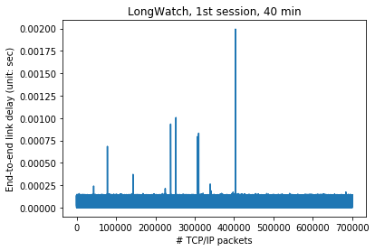
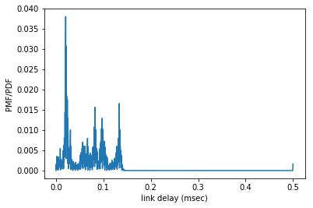
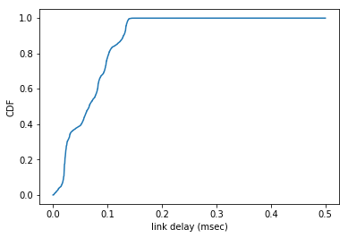
Statistical Results 1
One-way link transmission delay
First 40 minutes in a 100-part production :
Average end-to-end (SUP-OPT) delay: 65.94914005236618 us

Slide 18
TAP Measurements (ADS/AMS)
Network analyzer
PLC
(Supervisor)
PLC
(CNC x)
TAP
Lab Network
One-way link delay
ADS Request (Read/Write)
Process
-ing delay
Link RTT
Application
Round-trip time (RTT)
ADS Response
Time

Slide 19
A Trace File Example
STRUCT mStaRrpt
{
_nStaID: UINT; # 16b
_nState: UINT; # 16b
_nCode: UINT; # 16b
_bQueueOn: BOOL; # 8b
}
Supervisor
CNC_3
10.10.0.5
10.10.0.8
#94
Pkt ID | State Flag | Invoke ID | ADS Data | Index Group | Index Offset
#94 | ADS Req. | 0xff7d000b | GET_SYMHANDLE_BYNAME | 0x0000F003 | 0x00000000
#99 | ADS Resp. | 0xff7d000b | No Error
#120 | ADS Req. | 0xff7d000c | RD/WR_SYMVAL_BYNAME | 0x0000F005 | 0x58800039
#121 | ADS Resp. | 0xff7d000c | No Error
#138 | ADS Req. | 0xff7d000d | RELEASE_SYMHANDLE | 0x0000F006 | 0x58800039
#139 | ADS Resp. | 0xff7d000d | No Error
#99
#120
CNC Status Update
(10 Hz)
#121
#138
#139
#152
#160
Pkt ID | State Flag | Invoke ID | ADS Data | Index Group | Index Offset
#152 | ADS Req. | 0xff650012 | GET_SYMHANDLE_BYNAME | 0x0000F003 | 0x00000000
#160 | ADS Resp. | 0xff650012 | No Error
#176 | ADS Req. | 0xff650013 | RD/WR_SYMVAL_BYNAME | 0x0000F005 | 0x340000a1
#180 | ADS Resp. | 0xff650013 | No Error
#199 | ADS Req. | 0xff650014 | RELEASE_SYMHANDLE | 0x0000F006 | 0x340000a1
#204 | ADS Resp. | 0xff650014 | No Error
#176
#180
Working zone
Safety alert
(10 Hz)
#199
#204
Notes:
https://infosys.beckhoff.com/english.php?content=../content/1033/tcadsdeviceplc/html/tcadsdeviceplc_indexadsservice.htm&id=

Slide 20
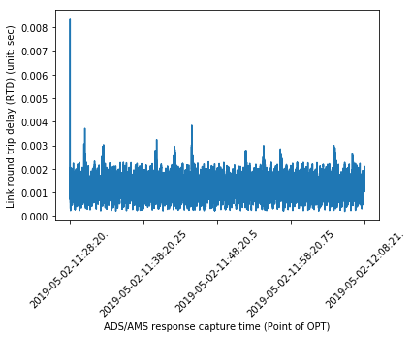
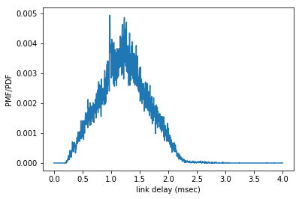
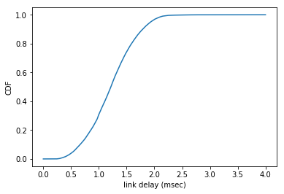
RTT of CNC Requests
1 outlier
CNC_3 status updates
Supervisor response time included
First 40 min in a 100-part production

Slide 21
Conclusion
Test bed and data will be released as reference model products for industrial wireless communication studies

Slide 22
Backup Slides
PTP
Network topology

Slide 23
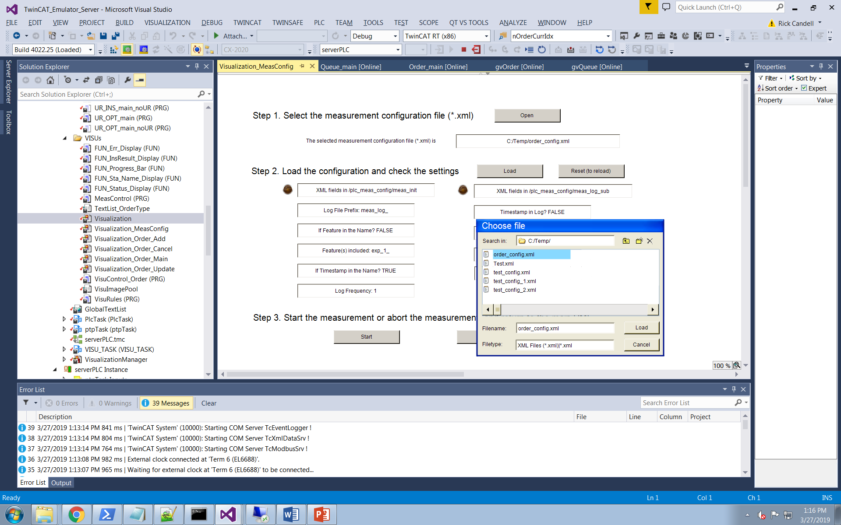
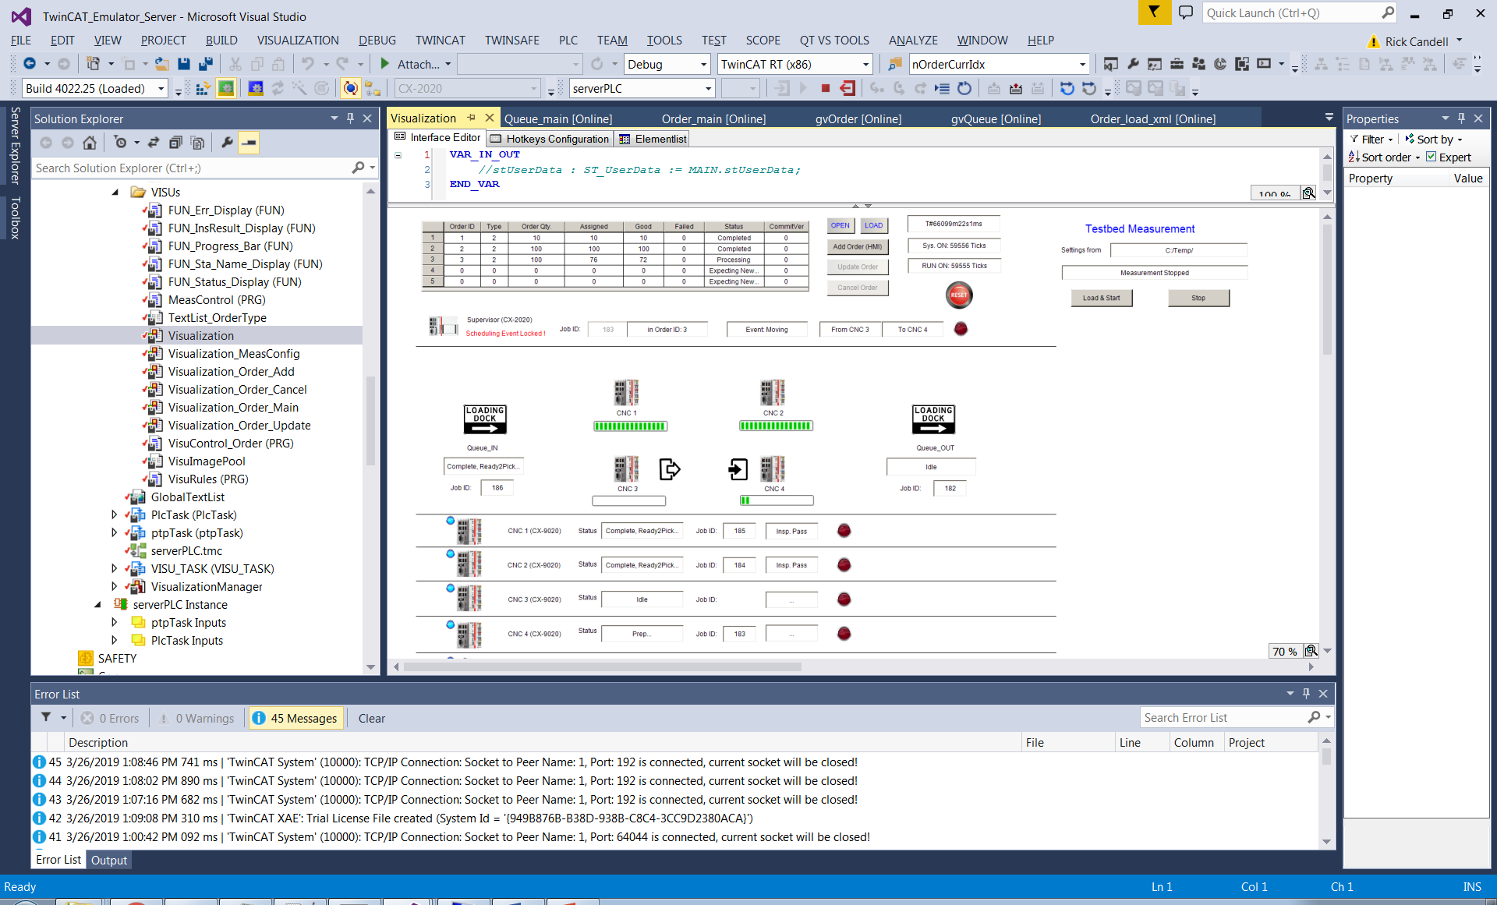
PLC Measurement Interface
HMI view for measurement configurations
Main HMI view
FileOpenSave dialog box

Slide 24
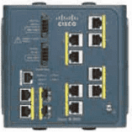
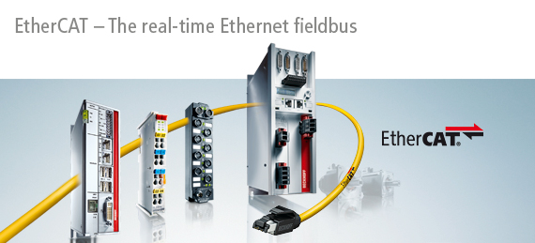
PLC Measurement Timing & PTP Sync
IEEE 1588-2008 (PTPv2)
End-to-end Delay Mechanism
IPv4 UDP multicast
Grandmaster (GM)
Ordinary Clock (OC)
Boundary Clock (BC)
PTP: 10.10.0.121
NTP: 10.10.0.120
EtherCAT distributed clock (DC)

Slide 25
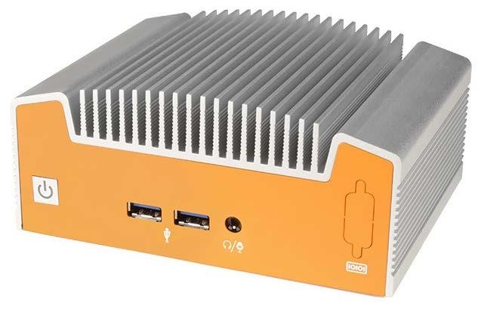

Suggested Baseline TSN Topology
(Option 1b: 2 UR Subnets)
10.20.0.15
INS
Control box
PLC
PLC 1588 Term
Grandmaster (GM)
INS_FT
Compute box
10.10.0.51
PTP: 10.10.0.121
Supervisor
10.20.0.25
10.10.0.5
TSN Switch
Cisco IE-3000-8tc
Kontron Switch
Kontron Switch
Kontron Switch
LinuxPTP
10.10.0.6
UR3 RTDE
CNC_1
Port mirroring
(Ingress & Egress)
10.10.0.91
10.10.0.92
10.20.0.26
10.10.0.7
CNC_2
RIVA
OPT_FT
Compute box
10.10.0.8
Wireshark
10.10.0.93
OPT
Control box
CNC_3
10.20.0.16
10.10.0.9
CNC_4
Notes:
Baseline network connections:
Production data (Green), measurement data (Red), and PTP/TSN links (Purple)

Slide 26
Suggested Baseline TSN Topology
(Option 2: 1 UR Subnet)
10.20.0.15
INS
Control box
PLC
PLC 1588 Term
Grandmaster (GM)
INS_FT
Compute box
10.10.0.51
PTP: 10.10.0.121
Supervisor
10.10.0.5
TSN Switch
Cisco IE-3000-8tc
10.20.0.25
Kontron Switch
Kontron Switch
UR3 RTDE
LinuxPTP
10.10.0.6
CNC_1
Port mirroring
(Ingress & Egress)
10.10.0.91
10.10.0.92
10.20.0.26
10.10.0.7
RIVA
CNC_2
OPT_FT
Compute box
10.10.0.8
Wireshark
10.10.0.93
OPT
Control box
CNC_3
10.20.0.16
10.10.0.9
CNC_4
Notes:
Baseline network connections:
Production data (Green), measurement data (Red), and PTP synchronization (Purple)

Slide 27

TBD: Wireless TSN Topology
(1 UR Subnet Case)
10.20.0.15
INS
Control box
PLC
PLC 1588 Term
Grandmaster (GM)
INS_FT
Compute box
10.10.0.51
PTP: 10.10.0.121
Supervisor
TAP
10.10.0.5
TSN Switch
Cisco IE-3000-8tc
10.20.0.25
Kontron Switch
LinuxPTP
Wireshark
10.10.0.6
10.10.0.92
CNC_1
10.10.0.93
10.20.0.26
10.10.0.7
RIVA
CNC_2
UR3 RTDE
OPT_FT
Compute box
10.10.0.8
10.10.0.91
OPT
Control box
CNC_3
10.20.0.16
10.10.0.9
Which NUC will act as the WLAN AP? (The AP may needs to connect to the IE-3000 for PTP referent time.)
CNC_4
Notes:
Baseline network connections:
Production data (Green), measurement data (Red), and PTP synchronization (Purple)

